Slide 1
Azure
Containers/Kubernetes
Express
MongoDB
M-C
Node.js
RESTful APIs
Typescript
Review of Backend Technologies Neil Saunders

Slide 2
What is Server-Side Development?
Using languages/frameworks to perform business logic, communicate with a database to perform CRUD operations, and authentication/authorization by utilizing on-premise or cloud services to provide data/views to the frontend (client facing) device based on a request from the client.
Common technology stack is the MERN stack:: M - MongoDB NoSQL database that uses JSON-like documents for storing data
E - Express is a JS backend web application framework for building RESTful APIs
Use on top of Node.js to manage servers
Utilizes middleware modules to perform additional tasks on request/response
R - React is a front-end single-page application framework N - Node.js is a run-time environment that runs JavaScript outside of a browser

Slide 3
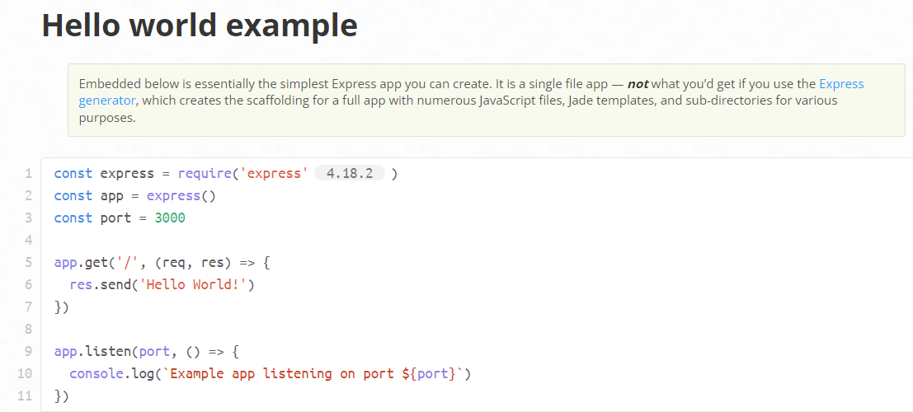
Express - Fast, Unopinionated, Minimalist
Web App Framework For Node.js
Used for routing, utilizing middleware to run code before/after a request/response, etc
https://expressjs.com/

Slide 4
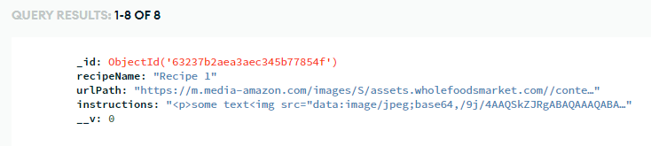
MongoDB - NoSQL, Open-Source Database (2007)
Store data in documents composed in JSON format. Documents are similar to rows of a SQL table & the value of a key is equivalent to a field in a SQL field of a column.
Advantages
High Speed/High Availability
Simplicity
Quick Setup
Flexibility
Scalability
Disadvantages
Doesnt’ join well like SQL dbases
Max size of 16MB for a document
Possible for duplicated data
High memory usage
https://www.mongodb.com/ https://www.mongodb.com/cloud

Slide 5
REST/RESTful APIs
REST is a set of architectural constraints, not a protocol or a standard. API developers can implement REST in a variety of ways.
When a client request is made via a RESTful API, it transfers a representation of the state of the resource to the requester or endpoint.
This information, or representation, is delivered in one of several formats via HTTP: JSON (Javascript Object Notation), HTML, XLT, Python, PHP, or plain text.
JSON is the most generally popular file format to use because, despite its name, it’s language-agnostic, as well as readable by both humans and machines.
REST APIs expect requests to come in one of the following forms: GET, POST, PUT, DELETE

Slide 6
TypeScript - Superset of JavaScript
JavaScript is a lightweight, weakly typed, interpreted programming language.
TypeScript is a strongly typed superset language built with/on top of JavaScript.
TypeScript is essentially Javascript that defines data types.
It is transpiled meaning that it needs to go through a “compilation” process. This can catch issues prior to running the code. The resulting file is a JavaScript file.
If you move code from JavaScript to TypeScript, it is guaranteed to run the same way even if TypeScript thinks that the code has type errors.
JavaScript will not throw an error/give incorrect results until run-time
This can lead to difficulty tracking down the source of the issue especially if there are 100s of files involved.
Worse is if the code makes it to the customer and they find the bug.
You can change the .js extension to .ts and review the errors that TypeScript is showing.
After transpilation, the TypeScript code is removed and you are left with JavaScript.
Helpful VS Code extensions: Code Runner (execute code from VS Code) &
Key Takeaway : If you know JavaScript, spend a little extra time learning TypeScript.
Reference: https://www.typescriptlang.org/docs/handbook/typescript-from-scratch.html

Slide 7
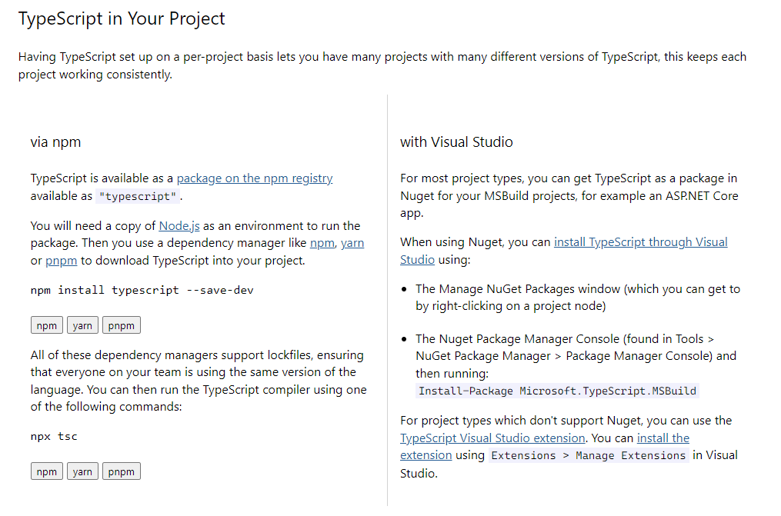
TypeScript Setup
https://www.typescriptlang.org/download

Slide 8
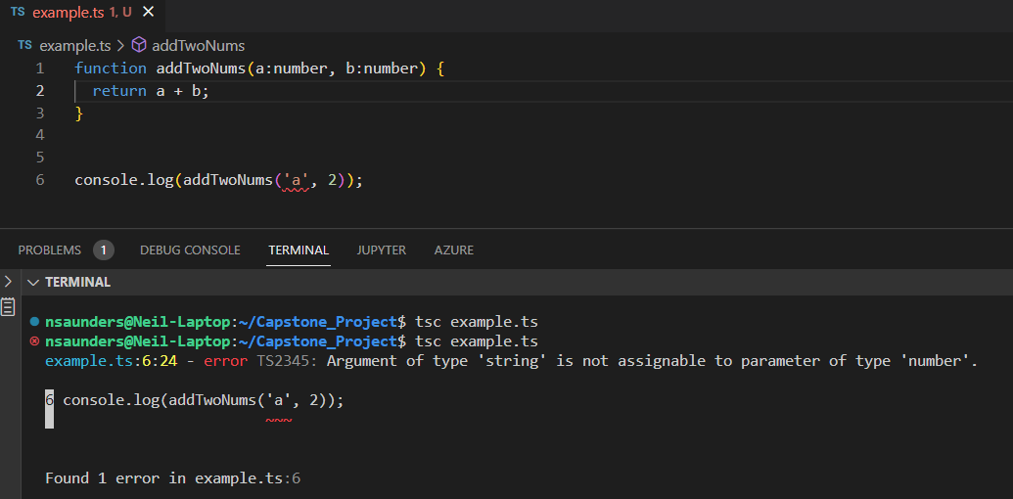
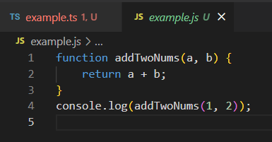
TypeScript Example
With VS Code extension or when trying to compile, notified of an issue.
After fixing, resulting code is a standard .js file with type checking removed
Normally, you have a separate

Slide 9
Model - Controller - Backend Design Pattern
Separation of Concerns: Model, View, and Controller
Model - Business logic, validation logic, and database access logic
Controller - Controls the application logic and routing of requests/responses by
obtaining data (from the model-if necessary), executing any middleware,
and returning the response to the user (in the browser)

Slide 10
Node.js
Node.js is an application that allows us to run javascript, on the server side, outside of a browser.
Node has npm which is a package manager that allows you to add frameworks/libraries.
Examples of frameworks/libraries are:
Express (web framework)
Async
Mongoose - Object Data Modeling library for MongoDB
Molecular
Grunt - JavaScript Task Runner (automation)
Mocha - Javascript test framework
https://nodejs.org/ https://www.turing.com/blog/top-npm-packages-for-node-js-developers/

Slide 11
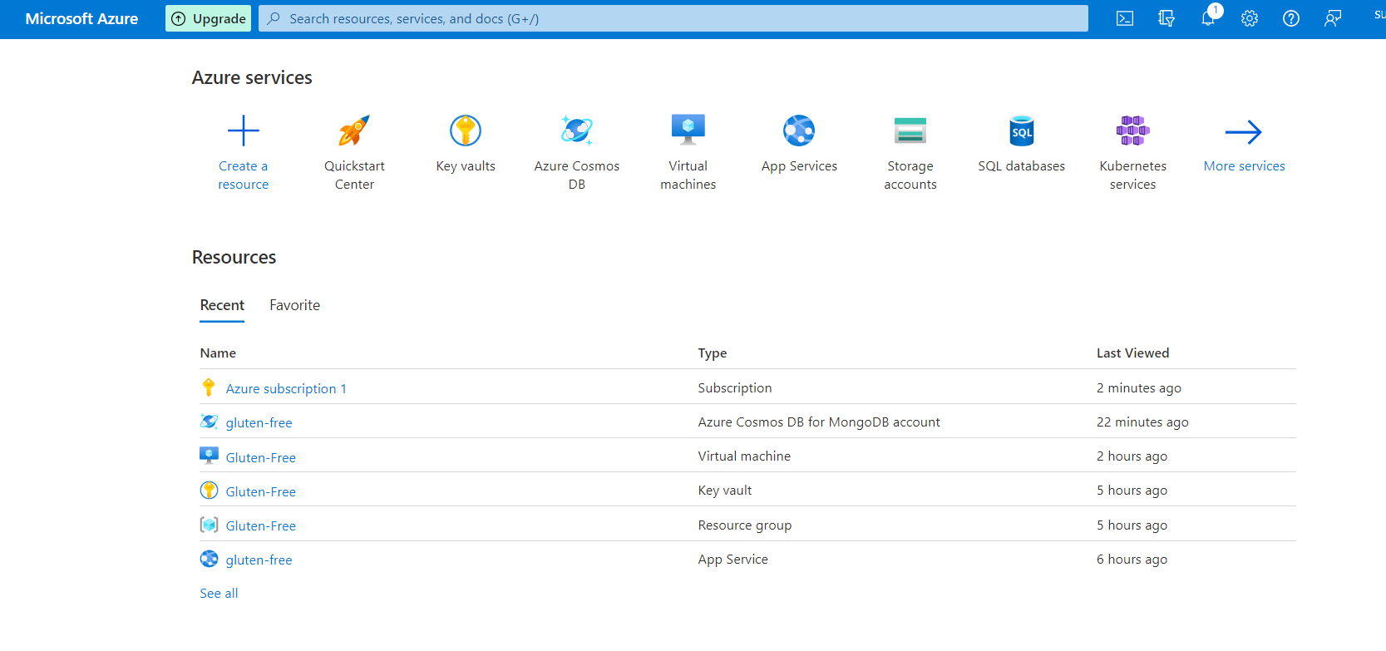
Microsoft Azure - Cloud Computing Service(free tier)
Azure Portal
Clicking on a service also shows some documentation/tutorials to learn more how to use each one.
There are quota limits so sometimes the web page not load.
https://learn.microsoft.com/en-us/azure/developer/ https://gluten-free.azurewebsites.net/

Slide 12
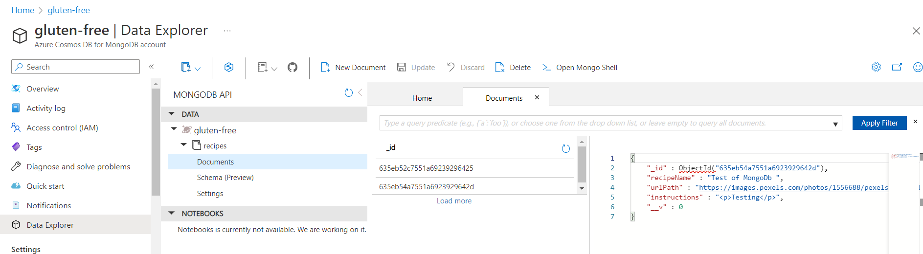
Microsoft Azure - Cloud Computing Service(free tier)
This also involved setting up a CosmosDB (Azure NoSQL database) that utilizes Mongoose framework.
https://learn.microsoft.com/en-us/azure/cosmos-db/mongodb/connect-using-mongoose has instructions on code that needs to be updated if using Mongoose.
https://learn.microsoft.com/en-us/azure/developer/

Slide 13
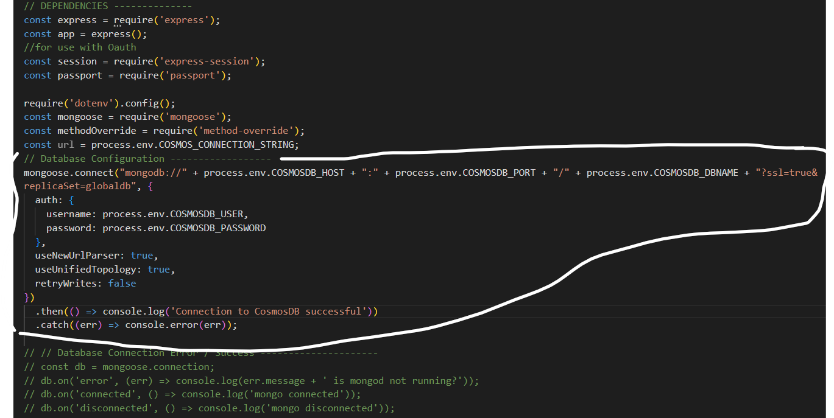
CosmosDB - contd.
server.js file

Slide 14
Docker / Containers
Docker is an open-source application which is used to develop, ship, & run containerized applications.
Containers are light-weight environments that contain everything you need to run your application.
They separate the application from the infrastructure.
Difference between Virtual Machine & Container is that a VM virtualizes everything down to the hardware layer where as a Container virtualizes software above the OS.
So a container does not have an OS, but share the host machine’s OS making it lightweight.
Each VM runs its own operating system (an instance of the host’s OS).
https://docs.docker.com/get-started/overview/#docker-objects

Slide 15
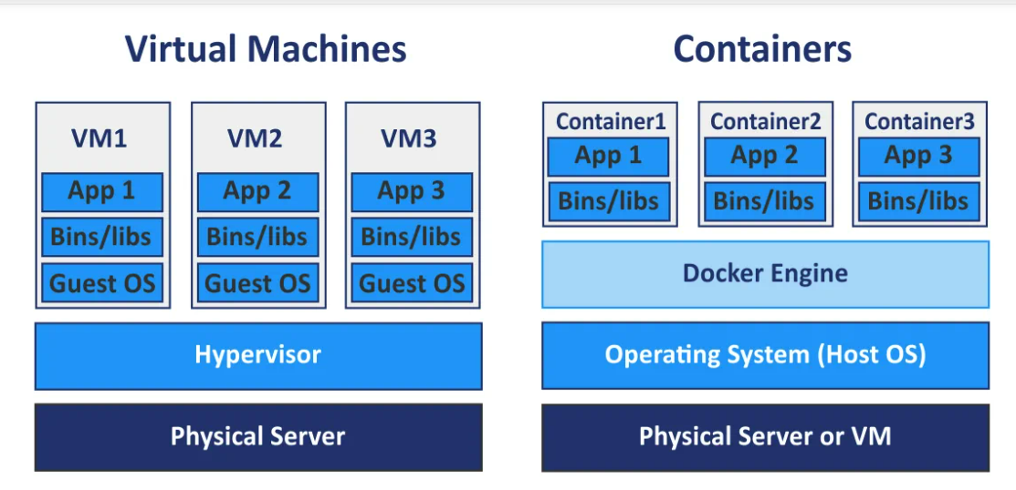
Containers cont.

Slide 16
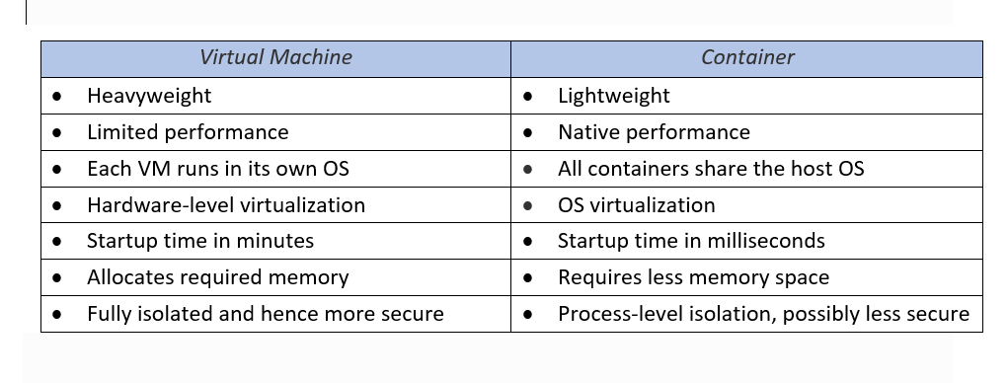
Containers cont.
https://akfpartners.com/growth-blog/vms-vs-containers

Slide 17
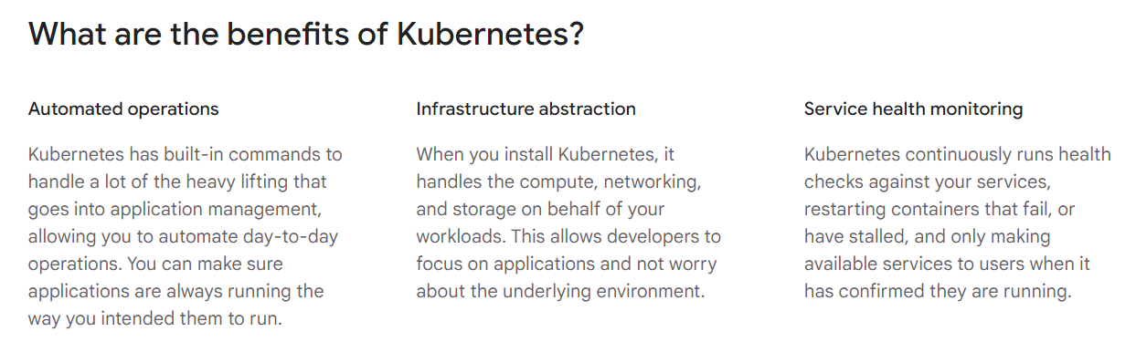
Kubernetes
Kubernetes is an open source container orchestration solution that manages containers.
Developed by Google as a way to automate deployment, scaling, and availability of applications running in containers.
https://www.nakivo.com/blog/docker-vs-kubernetes/ https://cloud.google.com/learn/what-is-kubernetes#:~:text=Google%20Cloud%20is%20the%20birthplace,from%20the%20open%20source%20community.

